Slide 1



Face Recognition Project
Deep Learning Approach for Celebrity Face Classification with Multiple Architectures

Slide 2



Dataset Overview & Statistics
Celebrity Face Dataset Analysis
Path: /Kaggle/input/celebrity-face-dataset-augmented
Format: JPG/JPEG/PNG images
Organization: Each celebrity in separate folder
Total Classes: 14 celebrities
Total Images: 3980 images
Images per Class: 259 – 431 (avg: 284)
Image Size: Resized to 224 x 224 pixels
Imbalance Ratio: Calculated and addressed
Dataset structure
Statistics

Slide 3
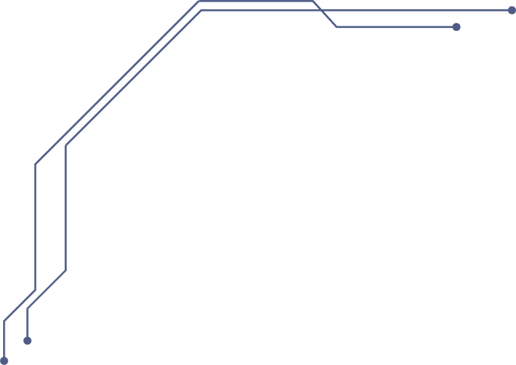

Data Preprocessing Pipeline
Step 1 - Image Loading
Step 2 - Data Split
Step 3 - Label Encoding
Step 4 – Class Balancing
All images resized to 224x224 pixels, format standardization
70%/15%/15% stratified split (Train/Val/Test), maintaining class distribution
Labels converted to categorical one-hot encoding for multi-class classification
Class weights computed to handle imbalance, ensuring fair training

Slide 4
Common Training Components
Loss Functions
Shared Techniques Across All Models
Categorical Crossentropy with label smoothing (0.15), Focal Loss (gamma=2.0, alpha=0.25)
Data Augmentation
rotation_range=25, width/height_shift=0.2, shear=0.2, zoom=0.25, horizontal_flip, brightness=[0.8,1.3]
Callbacks
EarlyStopping, ReduceLROnPlateau, ModelCheckpoint, EnhancedTrainingMonitor
Regularization
Dropout layers, L1/L2 regularization, class weights
Evaluation
Accuracy, Top-3 Accuracy, Confusion Matrix, ROC-AUC Curves

Slide 5

ResNet50 Architecture & Training
3-Phase Progressive Unfreezing Strategy
1
2
3
4
Level 4 (Top)
Custom Head: Dense layers (512→256→128→NUM_CLASSES) with BatchNorm and Dropout (0.6→0.5→0.4)
Level 3
ResNet50 Base: 4 stages with bottleneck blocks, global average pooling
Level 2
Intermediate Training: Last 20 layers unfrozen, LR=1e-4
Level 1 (Bottom)
www.reallygreatsite.com
Full Fine-tuning: All 175 layers trainable, LR=1e-5, Total Parameters: ~25.6M

Slide 6

ResNet50 Training Phases
Progressive Unfreezing Strategy
Phase 3 (Full Fine-Tune)
Phase 2 (Intermediate)
All layers trainable, LR=1e-5, complete network adaptation with regularization
Phase 1 (Warm-up)
Unfreeze last 20 layers, LR=1e-4, adapt middle layers to celebrity faces
Train head only for 27 epochs, LR=1e-3, frozen base, learn dataset patterns

Slide 7
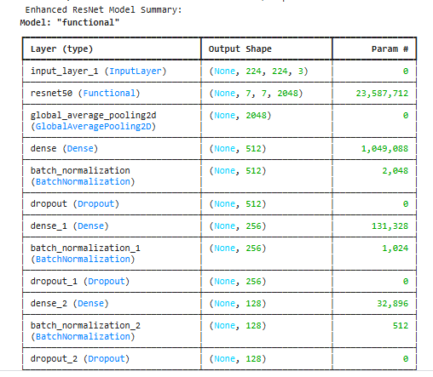
ResNet50 (Transfer Learning) Architecture
Architecture Details:
• Base Model: Pre-trained ResNet50 (ImageNet weights)
• ResNet50 Structure:
- 4 Stages with bottleneck blocks (1×1, 3×3, 1×1 convs)
- 50 layers total with skip connections
- Global Average Pooling layer
• Custom Classification Head:
- Dense(512) → BatchNorm → ReLU → Dropout(0.6)
- Dense(256) → BatchNorm → ReLU → Dropout(0.5)
- Dense(128) → BatchNorm → ReLU → Dropout(0.4)
- Dense(NUM_CLASSES) → Softmax
Training Strategy (Progressive Unfreezing):
1. Phase 1 (Warm-up): Train head only (27 epochs, LR=1e-3)
2. Phase 2 (Intermediate): Unfreeze last 20 layers (LR=1e-4)
3. Phase 3 (Full): Unfreeze all 175 layers (LR=1e-5)

Slide 8

MobileNet & Inception v1 Models
Efficient and Multi-Scale Approaches
MobileNet
Inception v1
Depthwise separable convolutions
~3M parameters
2-phase training (conservative→selective)
Efficient computation
Width multiplier=1.0
Trainable BatchNorm
Parallel convolutions
~6M parameters
PyTorch implementation
Auxiliary classifiers
Single-phase end-to-end training
Multi-scale feature extraction
Adam optimizer
ww.reallygreatsite.com

Slide 9
Inception V1 (GoogLeNet) Architecture
Architecture Details:
• Base Model: Pre-trained GoogLeNet (PyTorch implementation)
• Inception Modules:
- Parallel convolutions: 1×1, 3×3, 5×5 filters
- 3×3 max pooling with 1×1 projection
- Concatenation of all parallel paths
• Custom Head:
- Dropout(0.5)
- Linear(1024→512) → ReLU → BatchNorm1d → Dropout(0.3)
- Linear(512→NUM_CLASSES)
Multi-Scale Feature Extraction:
• 1×1 conv: Local features (eyes, mouth corners)
• 3×3 conv: Mid-level features (nose, eyebrows)
• 5×5 conv: Global features (face shape, hairline)
• Pooling: Dimensionality reduction

Slide 10
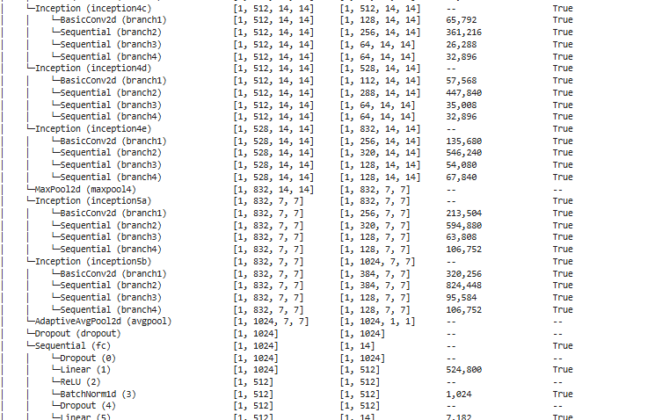
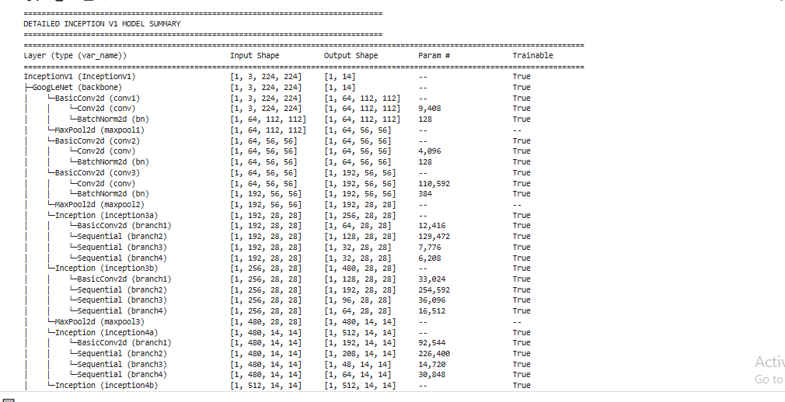
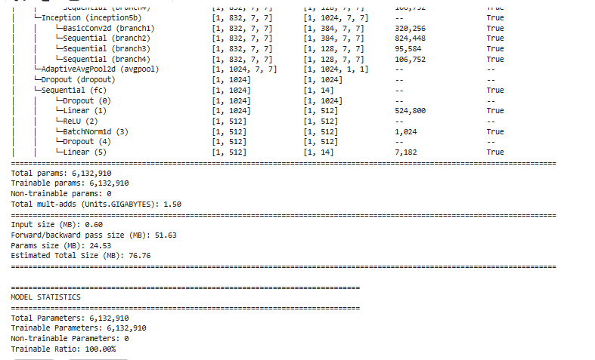
Inception V1 (GoogLeNet) Architecture

Slide 11
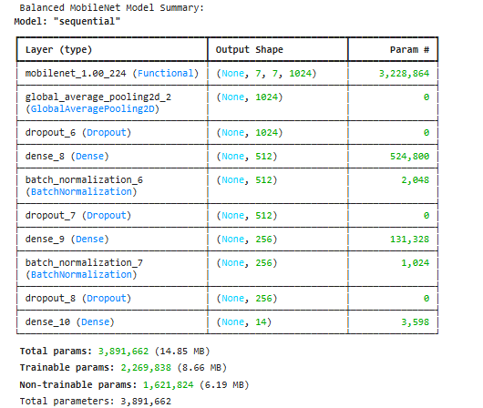
MobileNet Architecture
Architecture Details:
• Base Model: Pre-trained MobileNet (ImageNet weights)
• Depthwise Separable Convolutions:
- Depthwise convolution: 3×3 per channel
- Pointwise convolution: 1×1 across channels
- 4.2M parameters (efficient)
• Custom Head:
- Global Average Pooling2D
- Dropout(0.4)
- Dense(512) → BatchNorm → ReLU → Dropout(0.3)
- Dense(256) → BatchNorm → ReLU → Dropout(0.2)
- Dense(NUM_CLASSES) → Softmax
Training Strategy:
• Phase 1: Conservative (most layers frozen, BatchNorm trainable)
• Phase 2: Selective (unfreeze 30 layers, LR=5e-5)

Slide 12


VGG19 & Vision Transformer Models
From Scratch and Attention-Based Approaches
VGG19 (From Scratch)
ViT-B16
Built from scratch, ~3M parameters, 5 convolutional blocks with BatchNorm, Global Average Pooling, He initialization, gradient clipping, no transfer learning
Patch embeddings (16×16), 12 transformer layers, 12 attention heads, ~86M parameters, partial unfreezing (last 6 blocks), warmup + cosine decay

Slide 13
VGG-19 (From Scratch) Architecture
Architecture Details:
• Input: 224×224×3 RGB images
• 5 Convolutional Blocks:
- Block 1: 2×[Conv2D(32, 3×3) → BatchNorm → ReLU] → MaxPool2D(2×2)
- Block 2: 2×[Conv2D(64, 3×3) → BatchNorm → ReLU] → MaxPool2D(2×2)
- Block 3: 3×[Conv2D(128, 3×3) → BatchNorm → ReLU] → MaxPool2D(2×2)
- Block 4: 3×[Conv2D(256, 3×3) → BatchNorm → ReLU] → MaxPool2D(2×2)
- Block 5: 2×[Conv2D(256, 3×3) → BatchNorm → ReLU] → GlobalAvgPool2D
• Fully Connected Head:
- Dense(512) → BatchNorm → ReLU → Dropout(0.3)
- Dense(256) → BatchNorm → ReLU → Dropout(0.2)
- Dense(NUM_CLASSES) → Softmax
Key Features:
• All conv layers use 3×3 filters with same padding
• BatchNorm after every convolutional layer
• Global Average Pooling instead of Flatten
• He initialization for weight initialization
• Gradient clipping (norm=1.0) for stable training

Slide 14
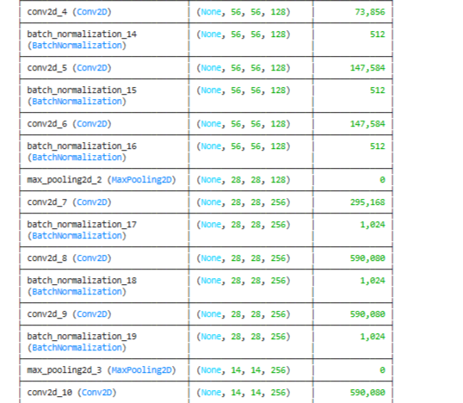
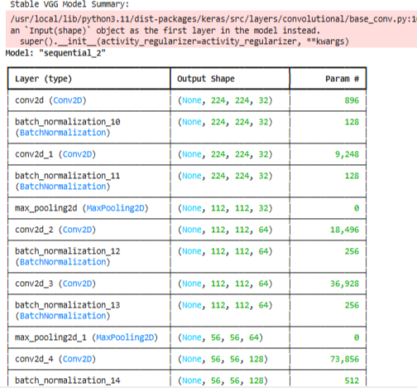
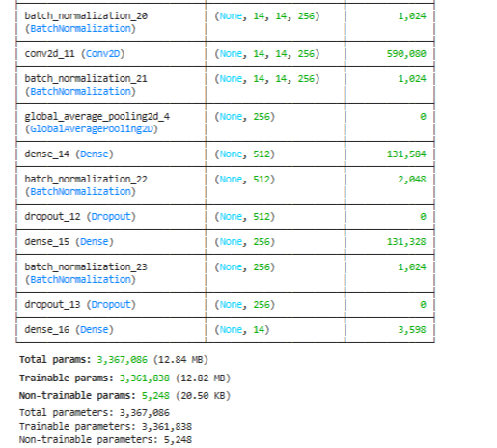
VGG-19 (From Scratch) Architecture

Slide 15
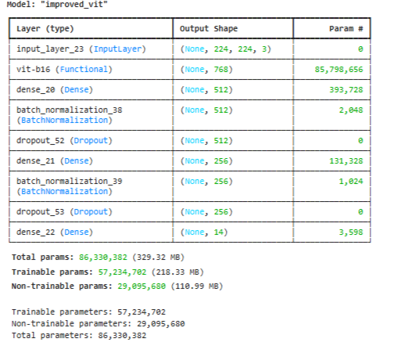
Vision Transformer (ViT-B16) Architecture
Architecture Details:
• Patch Embeddings: Split 224×224 image into 16×16 patches (196 patches)
• Transformer Encoder:
- 12 Transformer layers
- 12 attention heads per layer
- 86M parameters
• Custom Head:
- Dense(512) → BatchNorm → GELU → Dropout(0.5)
- Dense(256) → BatchNorm → GELU → Dropout(0.3)
- Dense(NUM_CLASSES) → Softmax
Training Strategy:
• Partial Unfreezing: Last 6 transformer blocks trainable
• Learning Rate: Cosine decay with warmup
• Regularization: L2 weight decay (1e-4)

Slide 16
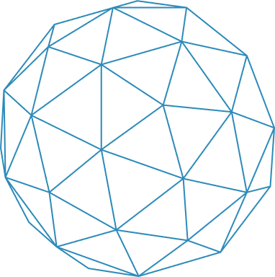
Model Performance Dashboard
Key Metrics & Best Performers
Accuracy: 0.9631 F1-score: 0.9633
Accuracy: 0.9430 F1-score: 0.9437
AUC: 0.9988 Time: 2033 s
Accuracy: 0.7521 F1-score: 0.7553
AUC: 0.9819 Time: 3982 s
AUC: 0.9993 Time: 2435 s
Resnet
MobileNet
Best Performers by category
Accuracy: Inception_V1 (0.9883)
AUC: Inception_V1(1.0000)
Efficiency: Fastest (683 s)
VIT
Inception_v1
Accuracy: 0.9883 F1-score: 0.9883
AUC: 1.0000 Time: 683 s
Accuracy: 0.9682 F1-score: 0.9689
AUC: 0.9995 Time: 1741 s
VGG_19

Slide 17
Architecture Comparison Matrix
Architecture | Core Innovation | Training Time | Best For | Worst For
Inception v1 | Multi-scale parallel conv | 683s | Multi-scale features, fast inference | High-resolution images
ResNet50 | Skip connections (identity) | 2435s | Very deep networks, transfer learning | Mobile/embedded deployment
MobileNet | Depthwise separable conv | 2033s | Mobile devices, real-time inference | Very complex patterns
VGG19 | Uniform 3x3 conv stacks | 1741s | From-scratch training, simplicity | Parameter efficiency
ViT (Vision Transformer) | Attention mechanism | 3982s | Large datasets, global context | Small datasets, compute-limited

Slide 18
Pros/Cons Analysis
Model | Advantages | Disadvantages | Task-Suitability
Inception v1 | Multi-scale feature extraction Parameter efficient Fast training (683s) High accuracy (98.83%) | Complex architecture Less interpretable Multiple auxiliary classifiers | EXCELLENT for face recognition - captures eyes, nose, mouth at different scales
ResNet50 | Skip connections prevent vanishing gradients Excellent transfer learning Consistent high performance | Heavy (~24M params) Slow training (2435s) Memory intensive | GOOD - robust but overkill for this dataset size
MobileNet | Extremely efficient (~3M params) Fast inference Mobile-optimized | Lower accuracy (94.30%) Feature extraction less powerful Needs careful tuning | MODERATE - trade accuracy for speed
VGG19 | Simple uniform architecture Easy to implement from scratch Good baseline | Parameter inefficient Slow convergence No pre-trained advantage | GOOD - reliable but not optimal
ViT-B16 | Global attention mechanism State-of-the-art on large datasets Excellent scaling | Requires huge datasets (>14M images ideal) Very slow training (3982s) Poor on small datasets (75.21%) | POOR - dataset too small for Transformers

Slide 19
Performance vs. Architectural Features
Architectural Feature | Inception V1 | ResNet50 | MobileNet | VGG19 | VIT
Multi-scale Processing | ✅ Excellent | ❌ Limited | ❌ Limited | ❌ Limited | ✅ Excellent
Parameter Efficiency | ✅ Good (~6M) | ❌ Poor (~24M) | ✅ Excellent (~3M) | ❌ Poor (~3M) | ❌ Very Poor (~86M)
Training Speed | ✅ Excellent (683s) | ❌ Poor (2435s) | ✅ Good (2033s) | ❌ Poor (1741s) | ❌ Very Poor (3982s)
Small Dataset Performance | ✅ Excellent | ✅ Good | ✅ Good | ✅ Good | ❌ Poor
Feature Reuse (Transfer) | ✅ Good | ✅ Excellent | ✅ Good | ❌ None (scratch) | ❌ Poor

Slide 20
Why Inception v1 Wins for Face Recognition
Facial Feature | Inception Advantage | How Architecture Helps
Multi-scale Features | Parallel 1x1, 3x3, 5x5 conv | Captures eyes (small), nose (medium), face outline (large) simultaneously
Pose Variation | Multiple receptive fields | Handles different angles and facial expressions
Lighting Conditions | Multiple filter combinations | Robust to shadows, highlights, uneven lighting
Fast Training | Efficient parameter use | Converges quickly (683s) with 3980 images
High Accuracy | Optimal complexity for dataset | 7M parameters - neither overfitting nor underfitting

Slide 21



Why Inception v1 Excels for Celebrity Face Recognition
🧠
Multi-Scale Architecture
⚖️
Dataset Size & Model Capacity
⚡
Multi-Scale Architecture
Small (1x1)
Local features: eyes, mouth corners
Inception V1
3980 images is sufficient for Inception’s ~6M parameters
Best accuracy (98.83%)
Mid-level features: nose, eyebrows
Medium (3x3)
Fastest training (683s)
ResNet
~24M parameters work but slower
Global features: face shape, hairline
Large (5x5)
Optimal trade-off: Not as sparse as MobileNet, not as dense as ResNet
VIT
86M parameters severely overparameterized → poor 75.21% accuracy
This aligns perfectly with how humans recognize faces.

Slide 22
Why Other Architectures Underperform
VIT (Vision Transform)
MobileNet
ResNet50
Problem: Transformers need massive data (ViT paper: 14M-300M images)
Our dataset: 3,980 images → 0.03% of minimum requirement
Result: Severe underfitting, poor attention learning
Problem: Too aggressive parameter reduction
Face recognition needs subtle feature discrimination
Depthwise separable conv loses too much information
Result: 94.30% accuracy (good but not best)
Problem: Overqualified for this task
Skip connections help with 100+ layers, but we only need 50
Extra parameters don't help, just slow training
Result: 96.31% accuracy but 5.6× slower than Inception

Slide 23
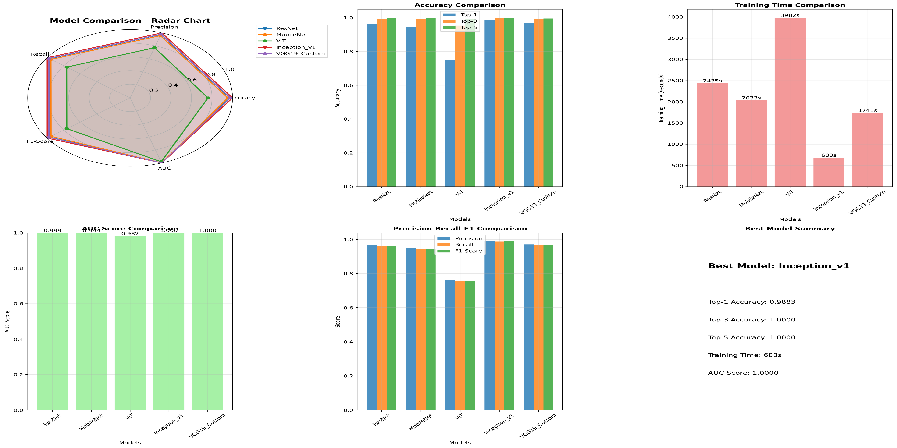
Models Plottings

Slide 24
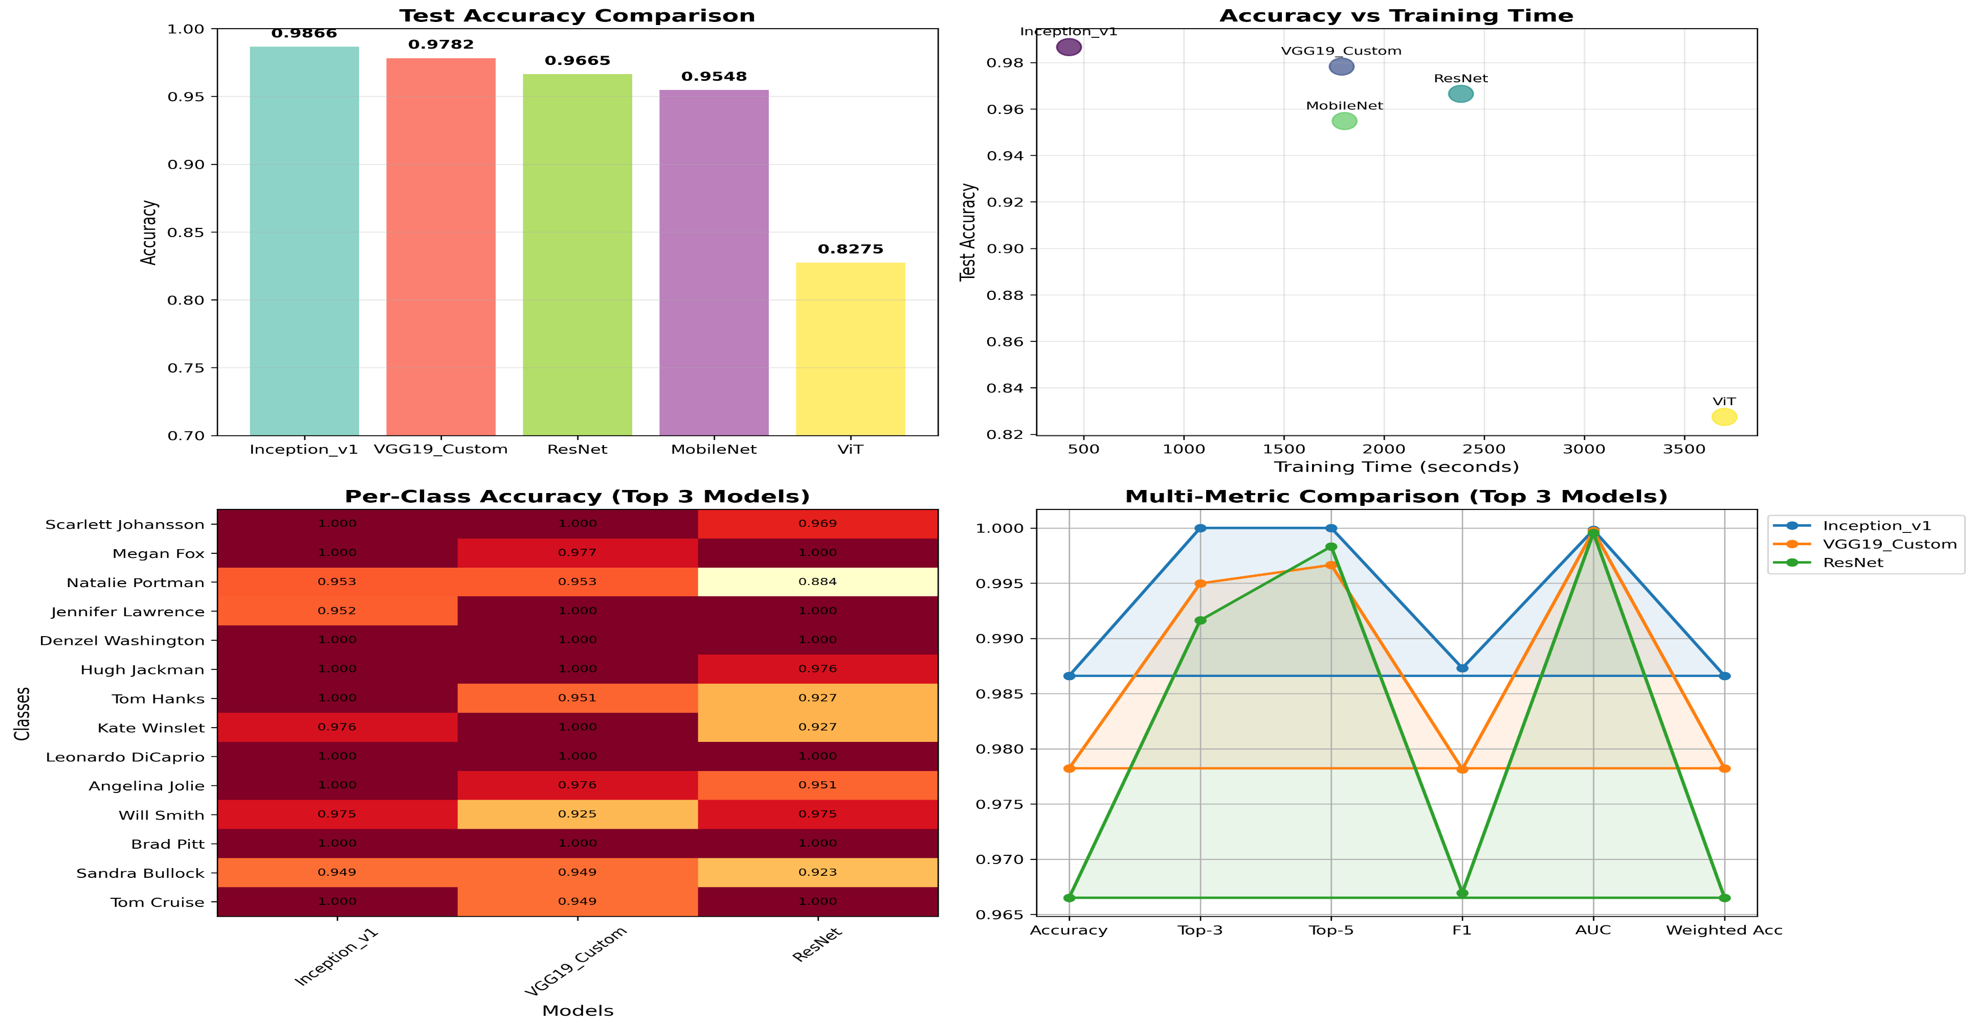
Models Plottings

Slide 25
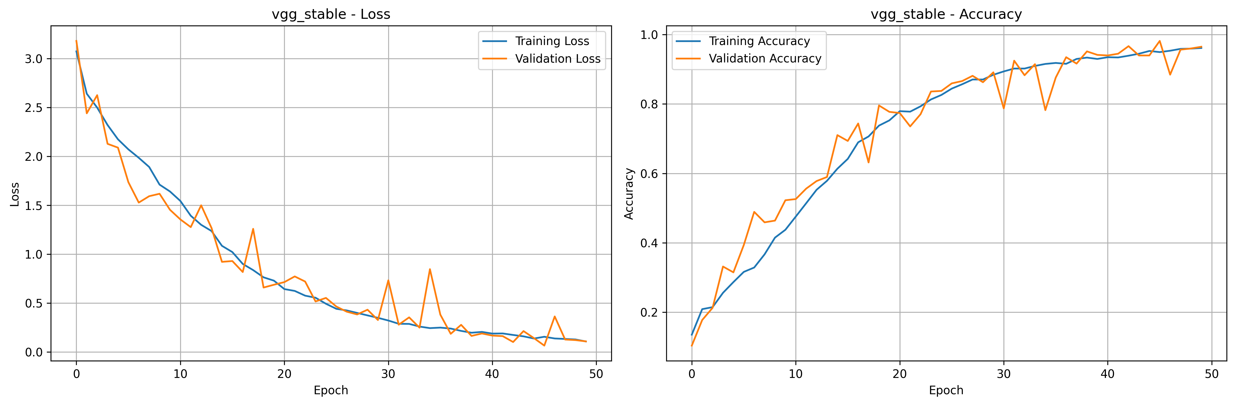
VGG Training Learning Curve

Slide 26
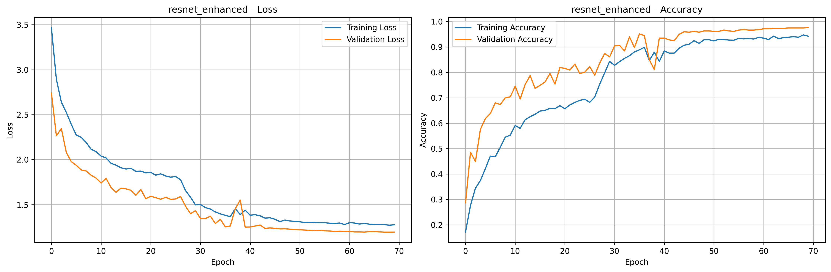
ResNet Training Learning Curve

Slide 27
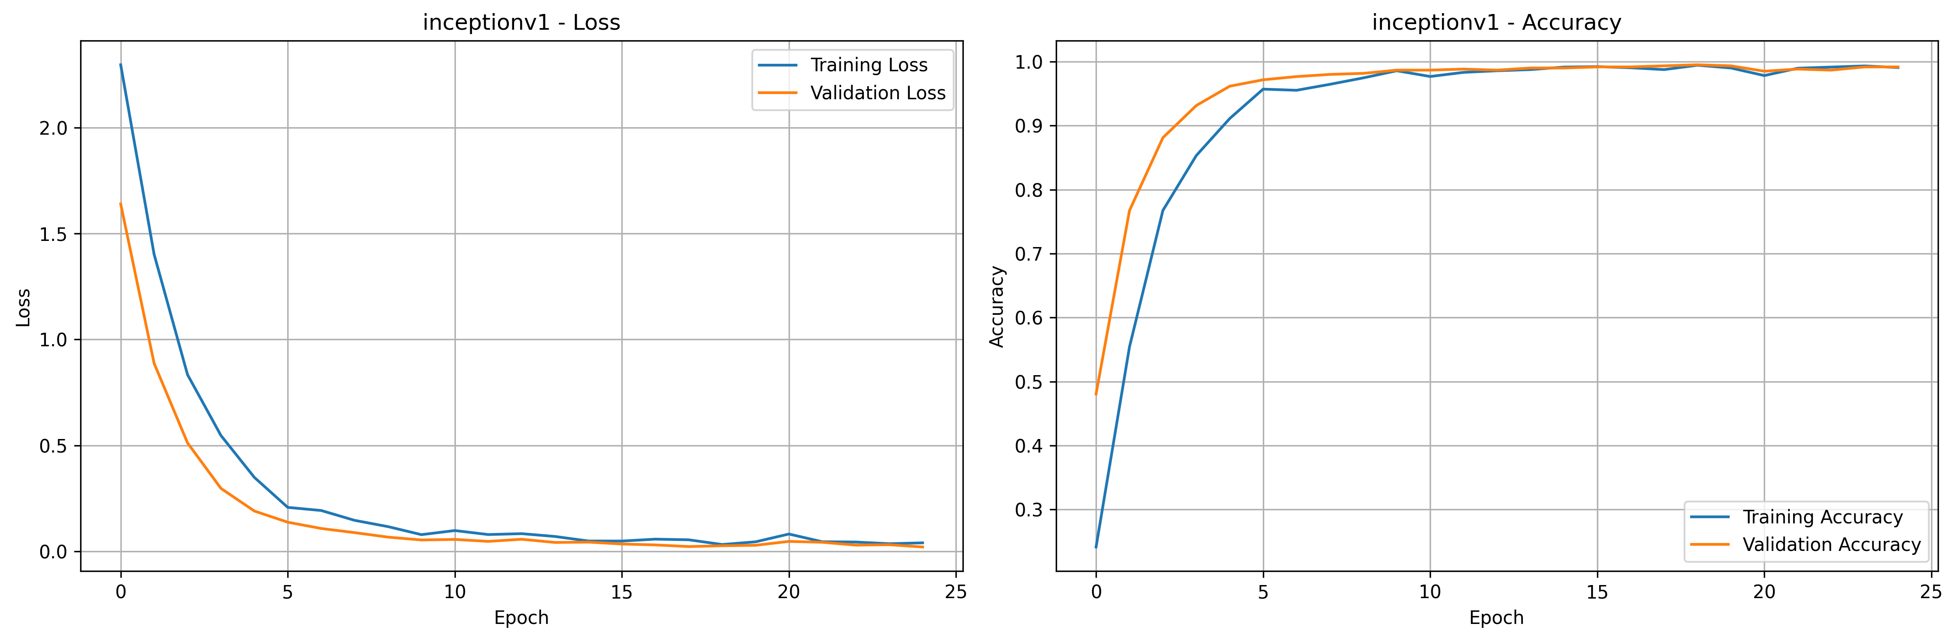
Inception_V1 Training Learning Curve

Slide 28
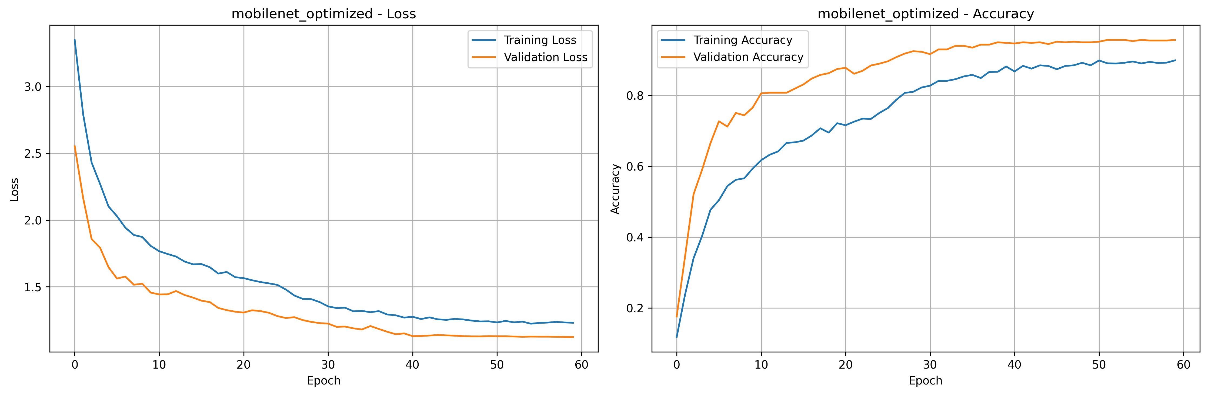
Mobile Net Training Learning Curve

Slide 29
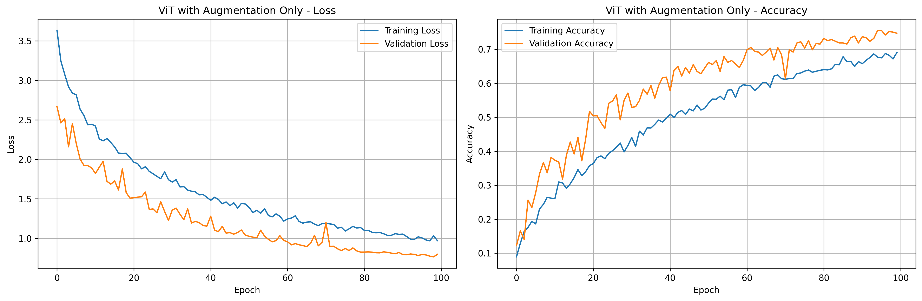
VIT Training Learning Curve

Slide 30
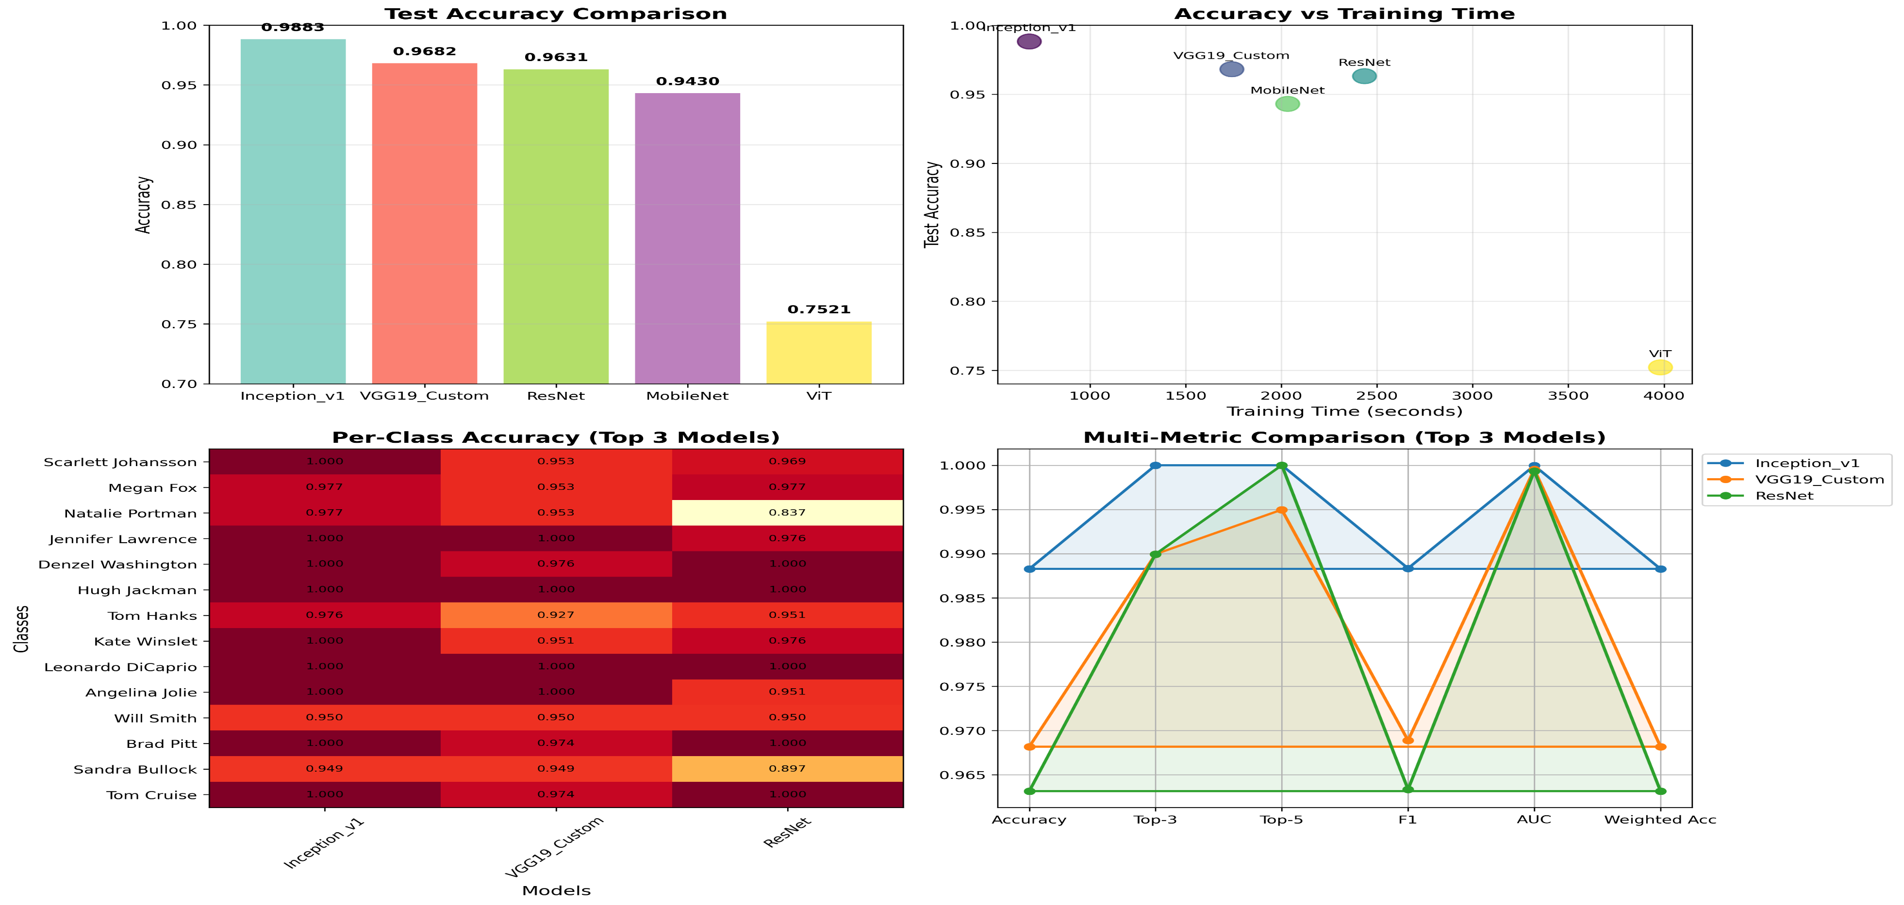
Test Accuracy Comparison

Slide 31
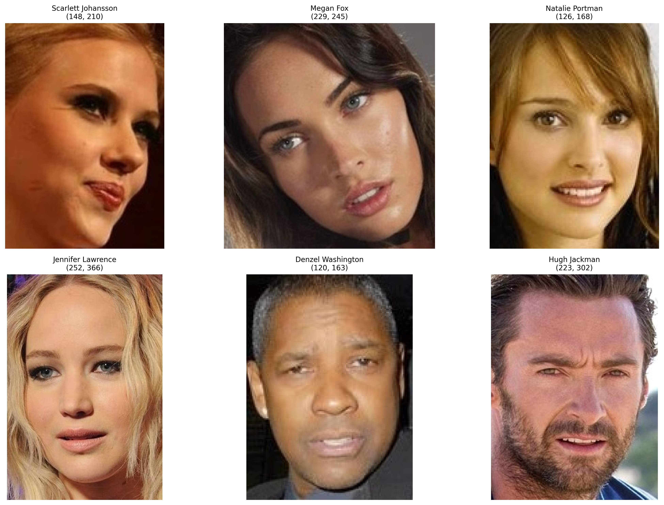
Sample of Images from Dataset

Slide 32
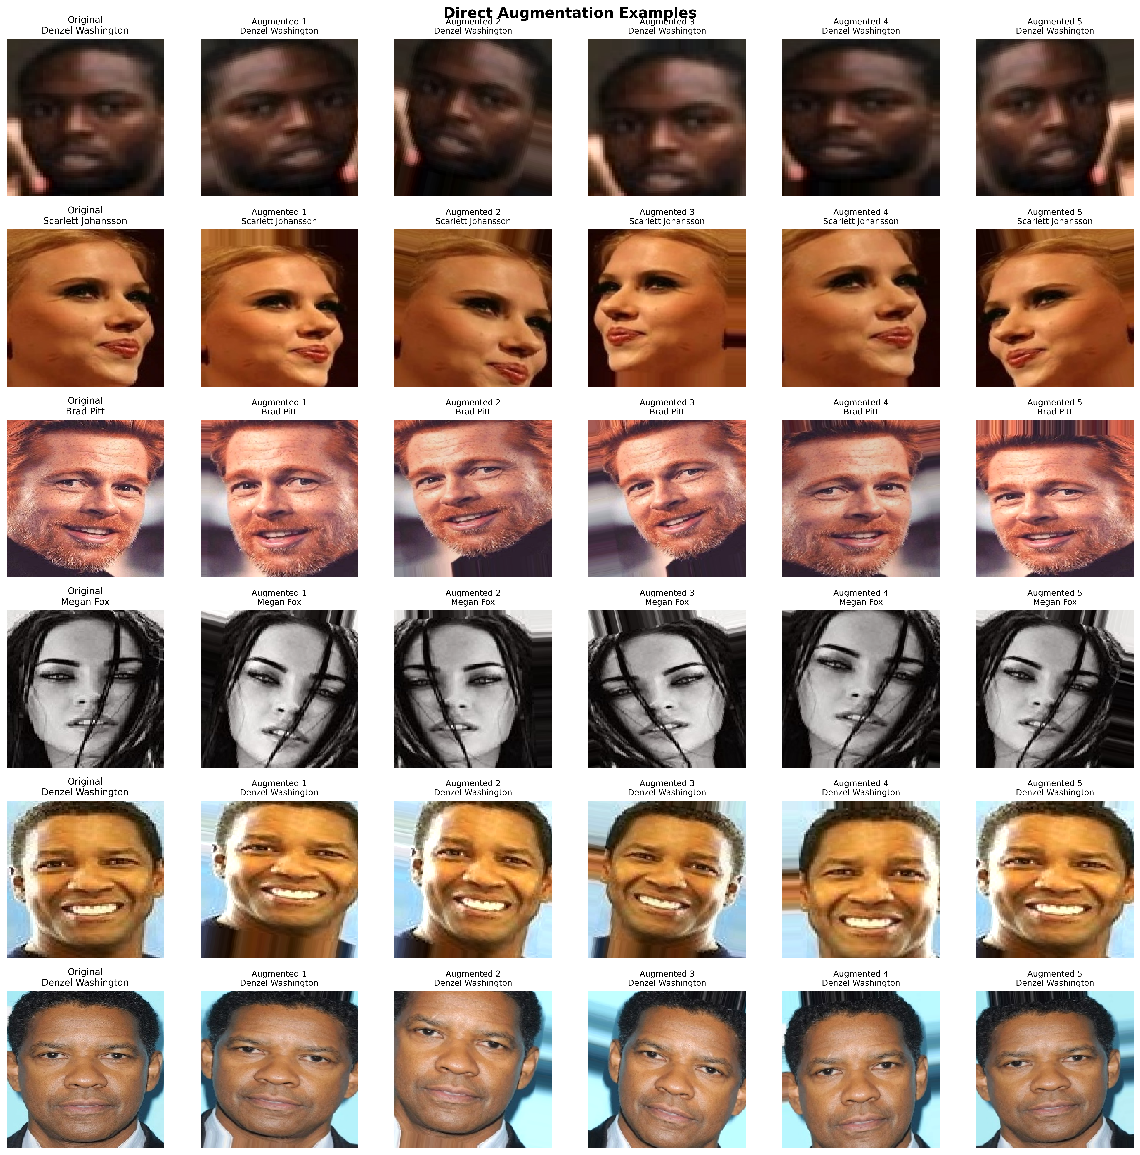
Augmented Samples from Dataset

Slide 33
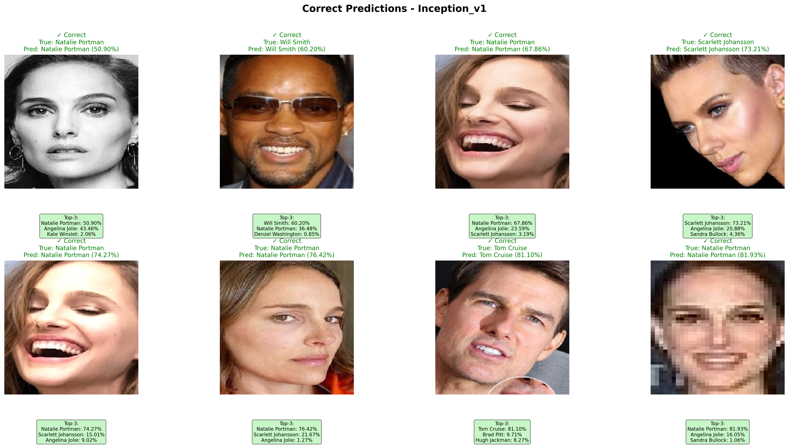
Correct Predictions From Best Model Inception_V1

Slide 34
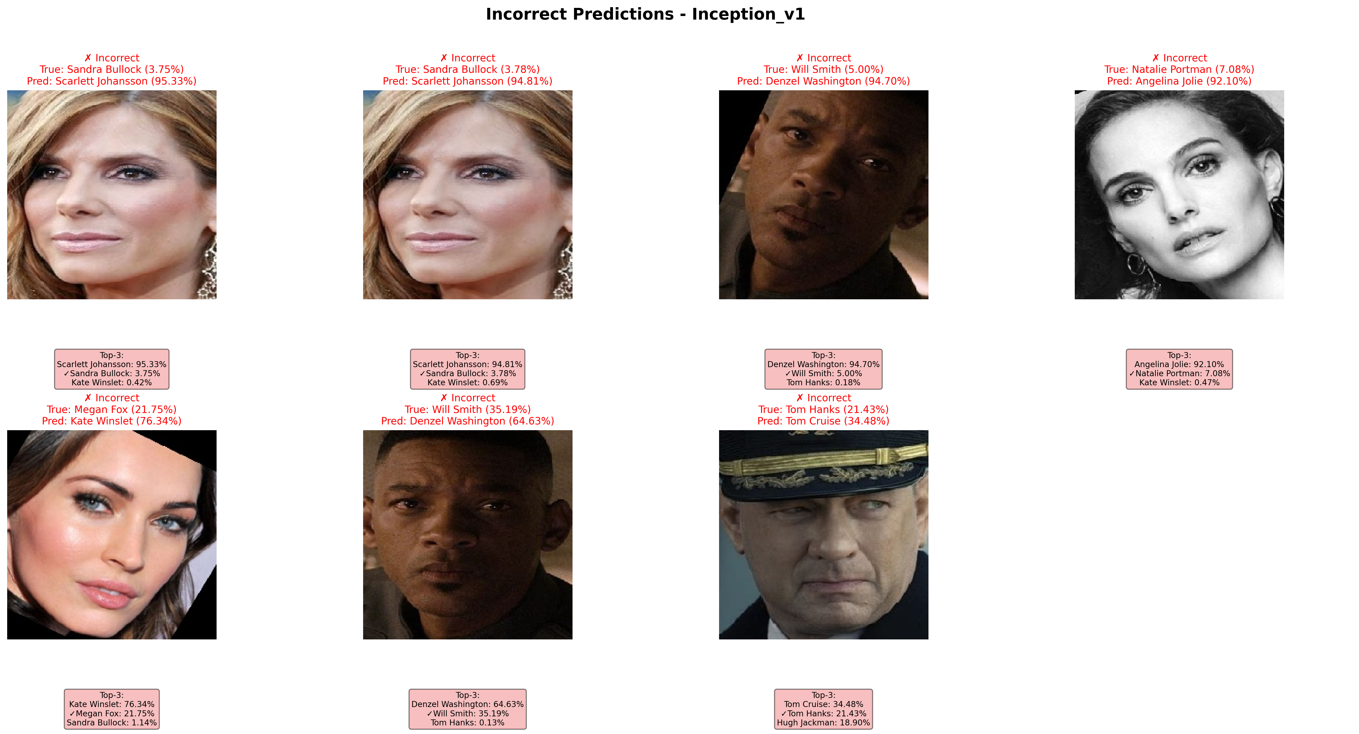
Incorrect Predictions From Best Model Inception_V1

Slide 35
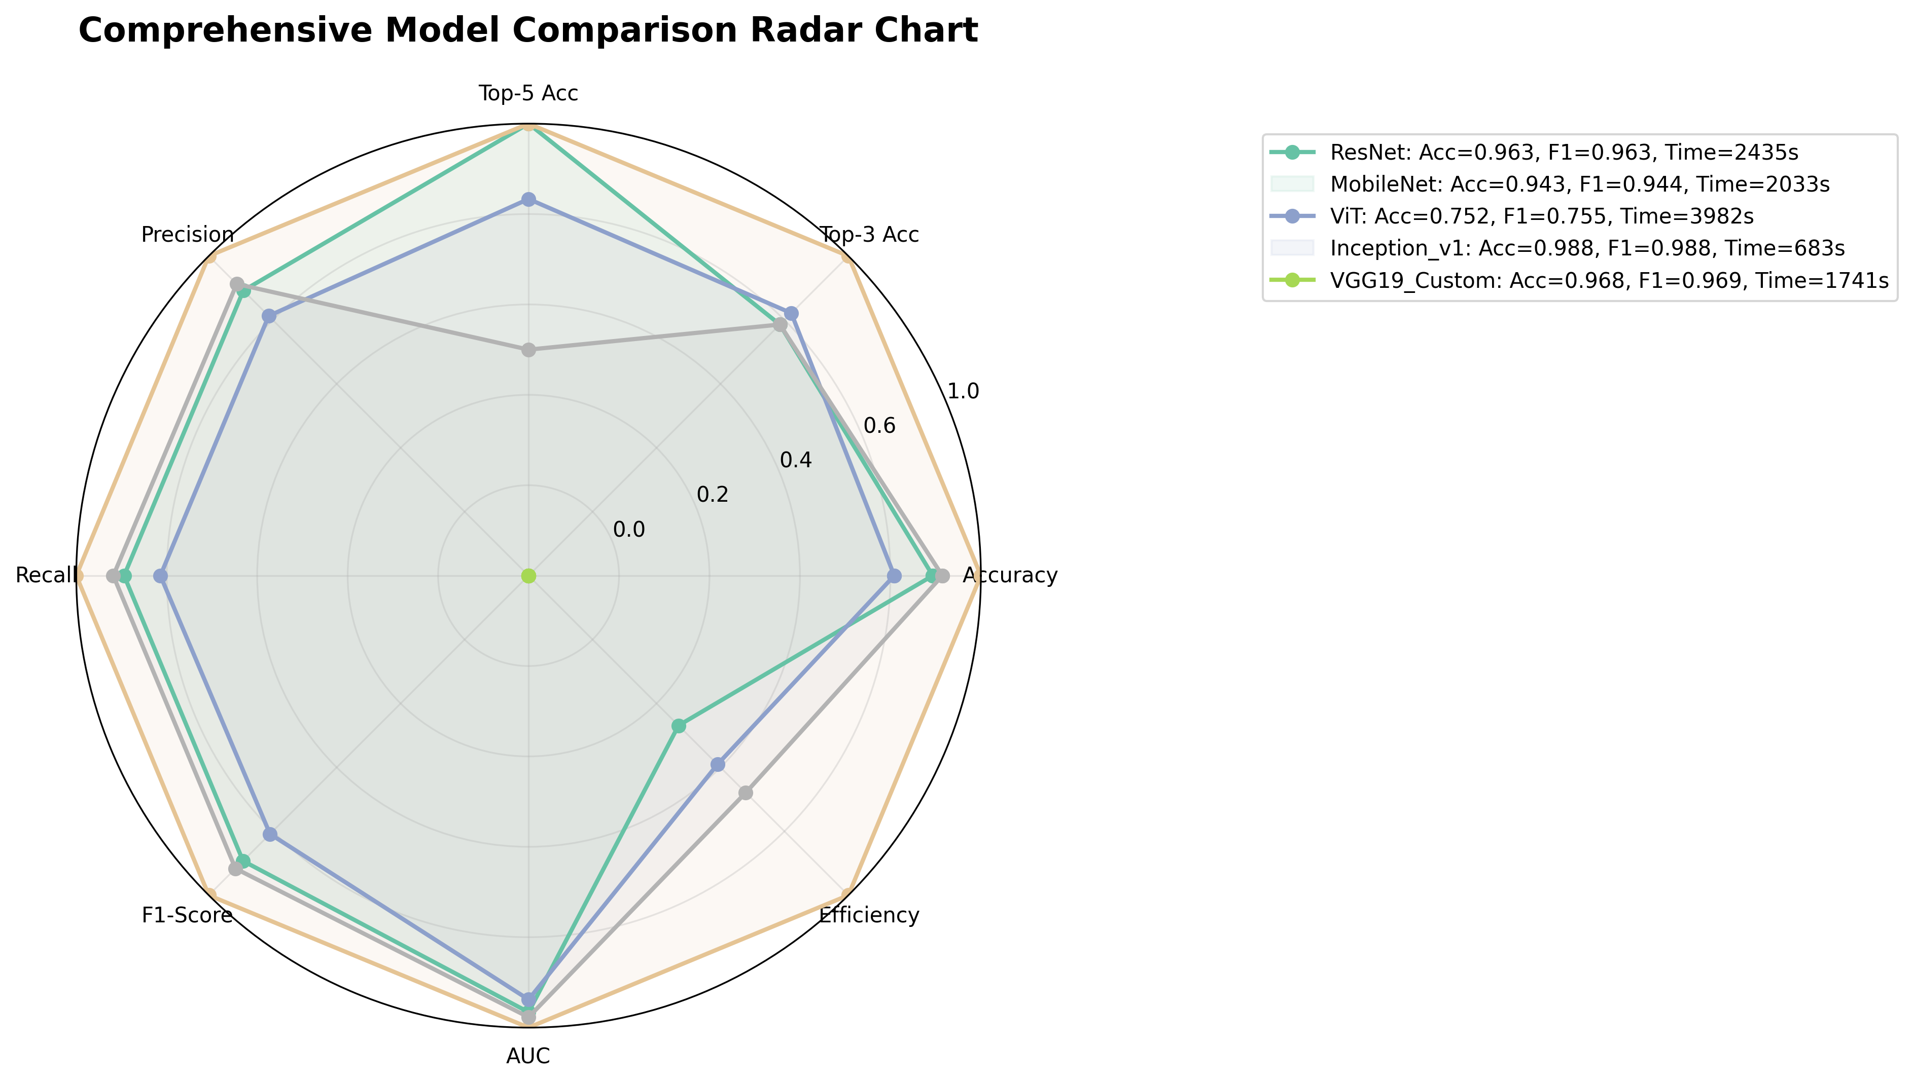
Comparison Radar Chart

Slide 36
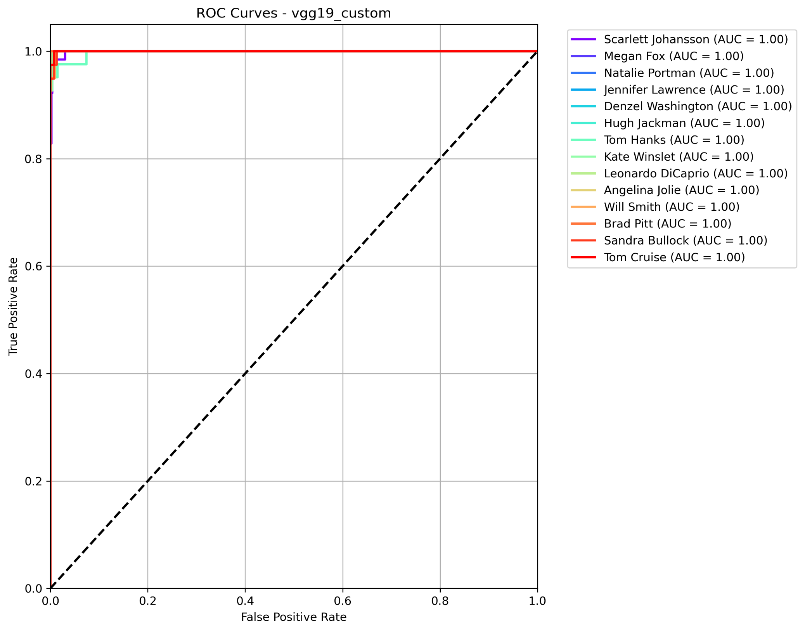
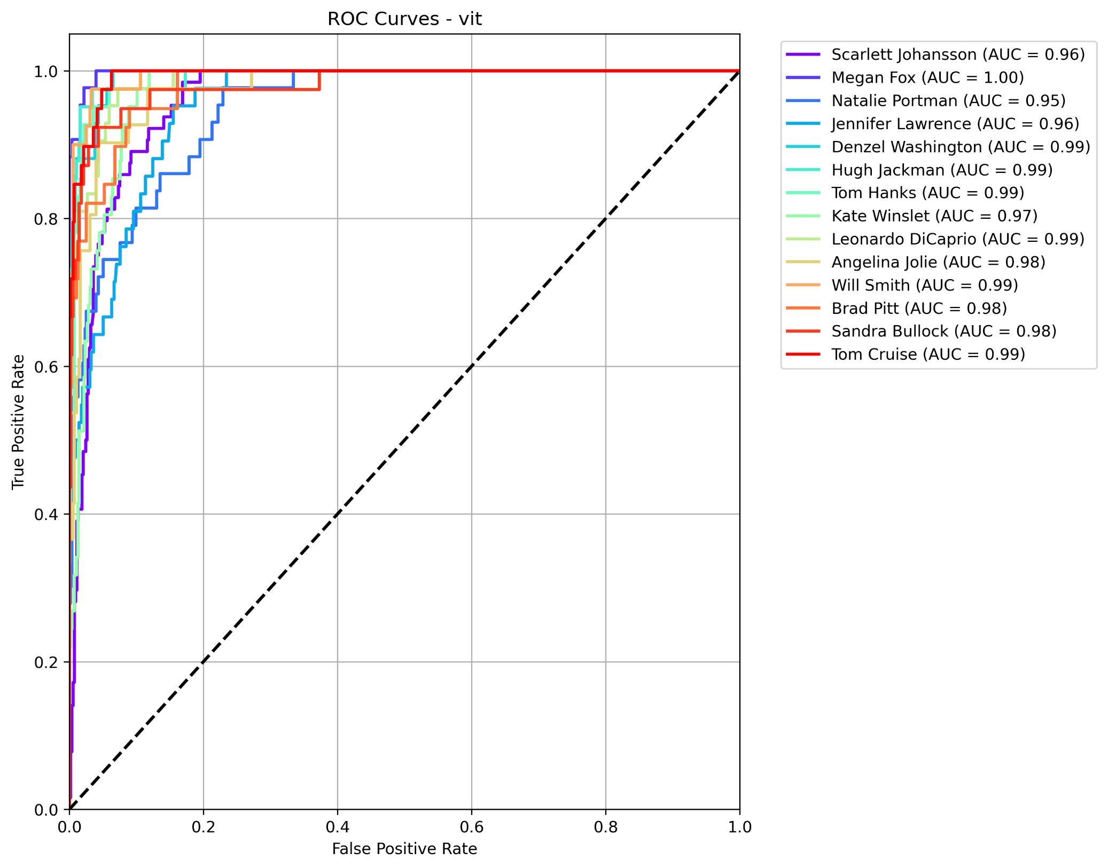
ROC Plottings of Models (Vit & VGG)

Slide 37
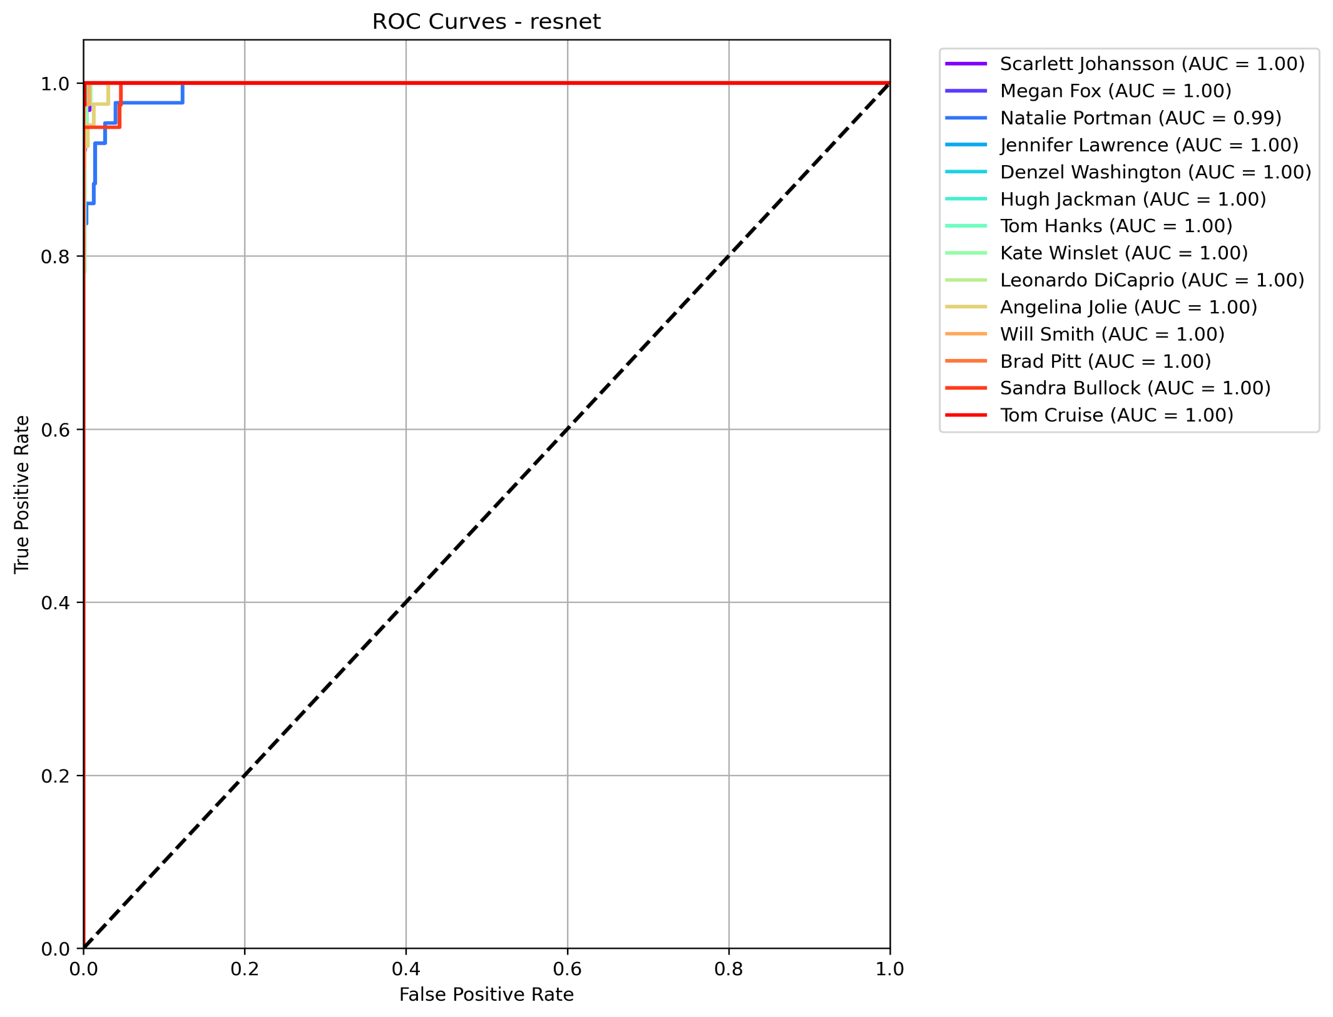

ROC Plottings of Models (ResNet & Mobile NET)

Slide 38
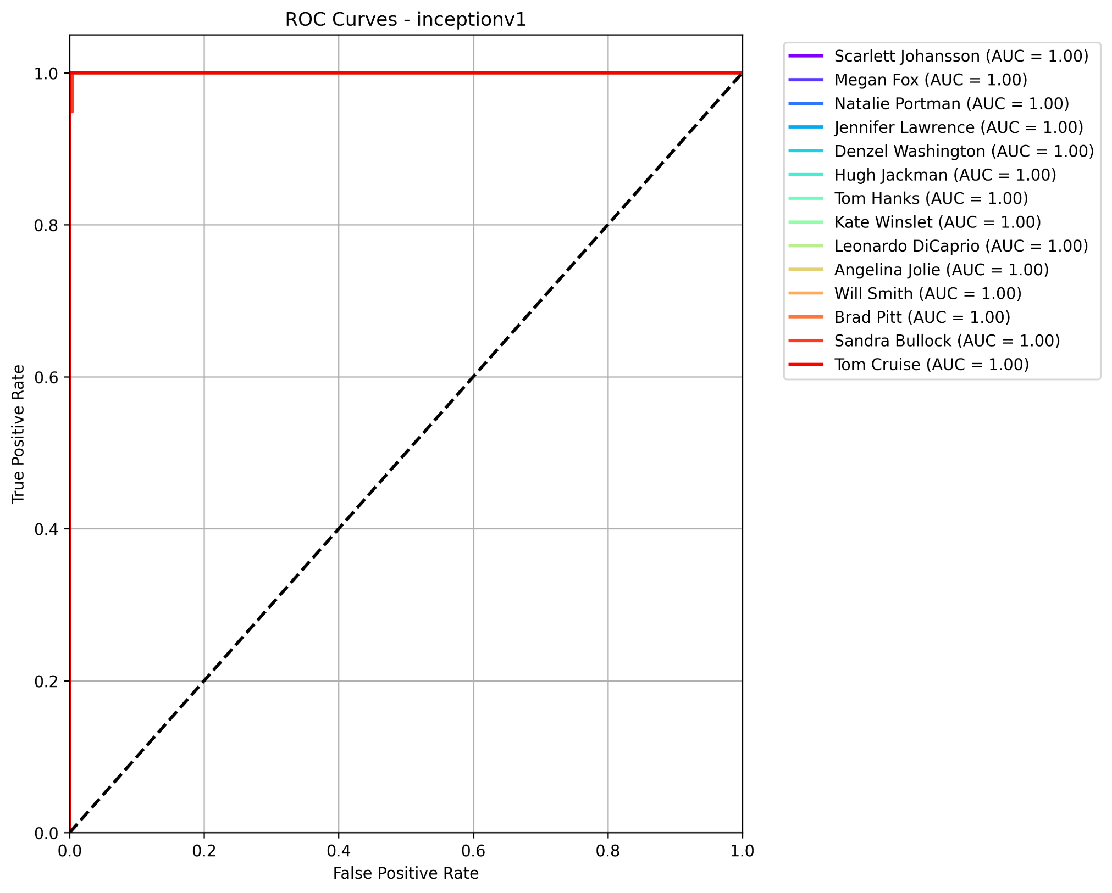
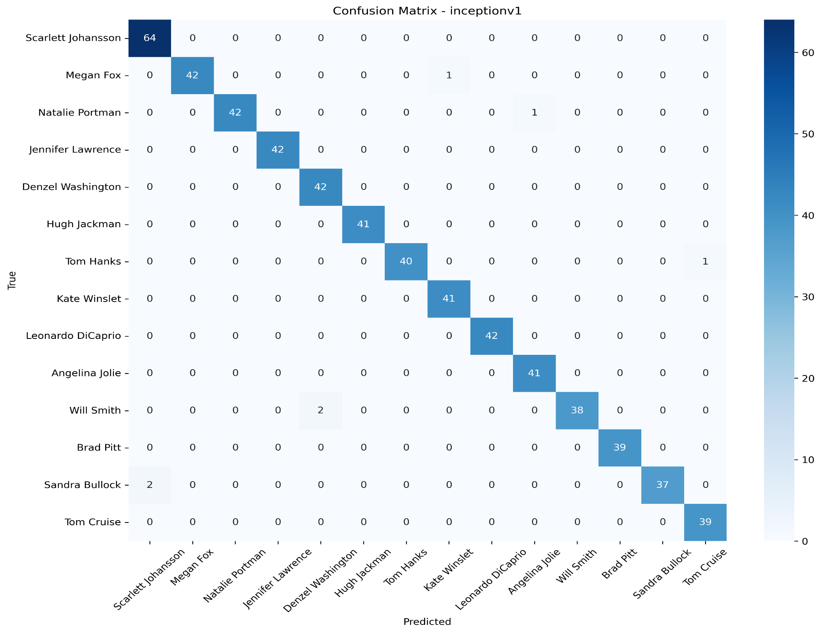
ROC & Confusion Matrix Plottings of Inception_V1

Slide 39
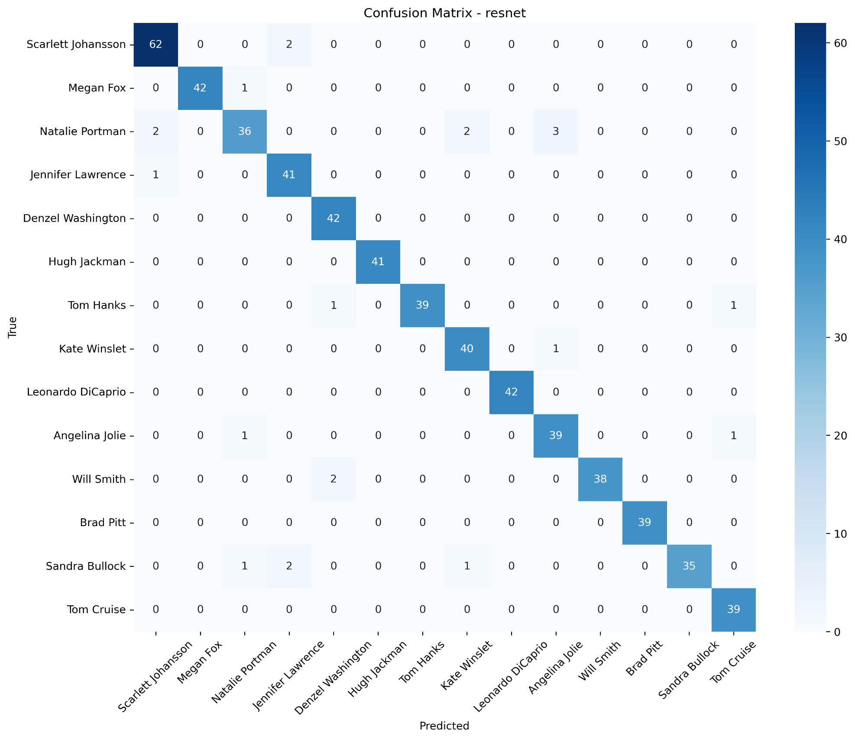

Confusion Matrix Plottings of Models (ResNet & MobileNet)

Slide 40
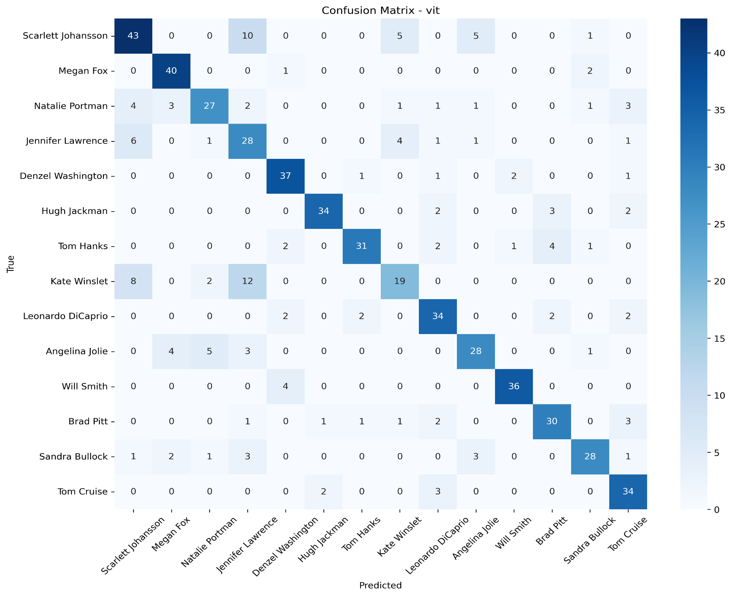
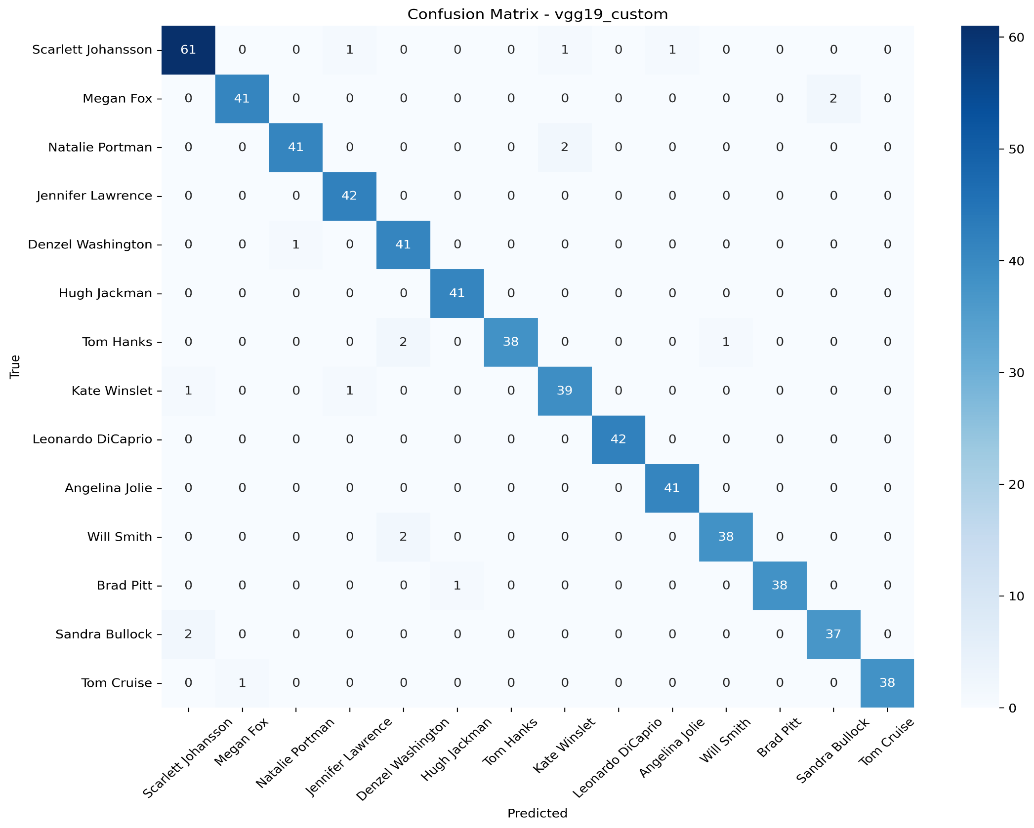
Confusion Matrix Plottings of Models (VGG_19 & Vit)

Slide 41
Papers References
ResNet
Paper: He, K., Zhang, X., Ren, S., & Sun, J. (2015). Deep Residual Learning for Image Recognition. 2015 IEEE Conference on Computer Vision and Pattern Recognition (CVPR).
Key Contribution: This landmark paper introduced the residual learning framework. The core innovation is the "skip connection" or "identity shortcut" that bypasses one or more layers, making it easier to optimize extremely deep networks by mitigating the vanishing gradient problem. Your project's use of the ResNet50 base model leverages these pre-trained residual blocks.
MobileNet
Paper: Howard, A. G., Zhu, M., Chen, B., Kalenichenko, D., Wang, W., Weyand, T., Andreetto, M., & Adam, H. (2017). MobileNets: Efficient Convolutional Neural Networks for Mobile Vision Applications. arXiv:1704.04861.
Key Contribution: This paper introduced an efficient network architecture based on depthwise separable convolutions. This technique factorizes a standard convolution into a depthwise convolution (applying a single filter per input channel) followed by a pointwise convolution (1x1 convolution to combine channel outputs), drastically reducing computation and model size. Your code utilizes this efficient base for on-device inference
Inception_V1
Paper: Szegedy, C., Liu, W., Jia, Y., Sermanet, P., Reed, S., Anguelov, D., Erhan, D., Vanhoucke, V., & Rabinovich, A. (2014). Going Deeper with Convolutions. 2014 IEEE Conference on Computer Vision and Pattern Recognition (CVPR).
Key Contribution: This paper introduced the Inception module, which performs convolutions with multiple filter sizes (1x1, 3x3, 5x5) in parallel and concatenates their outputs. This allows the network to capture multi-scale features efficiently within the same layer. It also used auxiliary classifiers during training to combat vanishing gradients in deep networks.
VGG_19
VIT
Paper: Simonyan, K., & Zisserman, A. (2014). Very Deep Convolutional Networks for Large-Scale Image Recognition. International Conference on Learning Representations (ICLR).
Key Contribution: This influential work systematically investigated the effect of convolutional network depth on accuracy. It established a simple, uniform architecture built from stacks of 3x3 convolutional layers and 2x2 max-pooling layers. The VGG16 and VGG19 models (with 16 and 19 weight layers, respectively) became standard benchmarks. Your custom VGG-style model follows this philosophy of sequential convolutional blocks.
Paper: Dosovitskiy, A., Beyer, L., Kolesnikov, A., Weissenborn, D., Zhai, X., Unterthiner, T., Dehghani, M., Minderer, M., Heigold, G., Gelly, S., Uszkoreit, J., & Houlsby, N. (2020). An Image is Worth 16x16 Words: Transformers for Image Recognition at Scale. International Conference on Learning Representations (ICLR)
Key Contribution: This paper broke from the convolutional paradigm by demonstrating that a pure Transformer architecture, with minimal modifications, could achieve state-of-the-art results on image classification. The key innovation is splitting an image into fixed-size patches, linearly embedding them, and adding position embeddings before feeding the sequence to a standard Transformer encoder.
www.reallgreatsite.com

